Slide 3
In the circuit of Figure 1, V_{a} = +3 V, V_{b} = +4 V, V_{c} = +5 V, R_{a} = R_{b} = R_{c}= 3 kΩ, R_{F} = 1 kΩ, R_{OM} = 270 Ω, and supply voltages = ± 15 V. Assuming that the op-amp is initially nulled, determine the output voltage Vo.
-2 V
-3 V
-4 V
-5 V

Slide 4
Answer : C

Slide 5
In the circuit of Figure 1, V_{a} = 200 mV, V_{b} = -300 mV, V_{c} = 400 mV, R_{a} = 3 kΩ, R_{b} = 2.2 kΩ,R_{c}= 1 kΩ, R_{F} = 4.7 kΩ, R_{OM} = 470 Ω and R_{L} = 10 kΩ, and supply voltages = ± 15 V. (i) Determine the output voltage Vo.
-0.55 V
-1.55 V
-2.55 V
-3.55 V

Slide 6
Solution: (i)V_{o} = -[R_{F}/R_{a} (V_{a}) + R_{F}/R_{b} (V_{b}) + R_{F}/R_{c} (V_{c})]
= -[(4.7/3)(200) + (4.7/2.2)(-300) + (4.7/1)(400)]
= -[313.33 – 640.90 + 1880]
= -1552.43 mV = -1.552 V = -1.552 V
Answer : B

Slide 7
In the circuit of Figure 1, V_{a} = 150 mV, V_{b} = -350 mV, V_{c} = 450 mV, R_{a} = 3 kΩ, R_{b} = 2.2 kΩ,R_{c}= 1 kΩ, R_{F} = 4.7 kΩ, R_{OM} = 470 Ω and R_{L} = 10 kΩ, and supply voltages = ± 15 V. (i) Determine the output voltage Vo.
-1.602 V
-2.602 V
-4.602 V
-5.602 V

Slide 8
Solution: (i)V_{o} = -[R_{F}/R_{a} (V_{a}) + R_{F}/R_{b} (V_{b}) + R_{F}/R_{c} (V_{c})]
=-[(4.7/3)(150) + (4.7/2.2)(-350) + (4.7/1)(450)]
= -[235 – 747.72 + 2115]
= -1602.28 mV = -1.602 V = -1.602 V
Answer : A

Slide 11
In the circuit of Figure 2, V_{a} = +3 V, V_{b} = -3 V, V_{c} = +3 V, R = R₁ = 1 kΩ, R_{F} = 2 kΩ. Determine the voltage V₁ at the non-inverting terminal. Assuming that the op-amp is initially nulled.
0.1 V
1.0 V
0.2 V
2.0 V

Slide 12
Solution: (i)V₁ = [V_{a} + V_{b} + V_{c}]/3
= [3 + (-3) + 3]/3
= 1.0 V
Answer : B

Slide 13
In the circuit of Figure 2, V_{a} = +5 V, V_{b} = -5 V, V_{c} = +9 V, R = R₁ = 1 kΩ, R_{F} = 2 kΩ. Determine the output voltage V_{o}. Assuming that the op-amp is initially nulled.
7 V
8 V
9 V
10 V

Slide 14
Solution: (i)V₁ = [V_{a} + V_{b} + V_{c}]/3
= [5 + (-5) + 9]/3
= 3.0 V
V_{o} = (1+R_{F}/R₁)V₁ = (1+2) 3 = 9 V
Answer : C

Slide 15
In the circuit of Figure 2, V_{a} = +5 V, V_{b} = -5 V, V_{c} = +9 V, R = R₁ = 1 kΩ, R_{F} = 3 kΩ. Determine the output voltage V_{o}. Assuming that the op-amp is initially nulled.
12 V
13 V
14 V
15 V

Slide 16
Solution: (i)V₁ = [V_{a} + V_{b} + V_{c}]/3
= [5 + (-5) + 9]/3
= 3.0 V
V_{o} = (1+R_{F}/R₁)V₁ = (1+3) 3 = 12 V
Answer : A

Slide 19
In the circuit of Figure 2, R = 1 kΩ, V_{a} = +9 V, V_{b} = +5 V, V_{c} = +5 V, V_{d} = +6 V. Determine the output voltage V_{o}.
1 V
2 V
3 V
4 V

Slide 20
Answer : C

Slide 23
In the circuit of Figure 1, V_{in} = 5 V, R = 20 kΩ, and V₁ = 2 V. Find the load current.
0.05 mA
0.10 mA
0.15 mA
0.25 mA

Slide 24
Solution: I_{L} = V_{in} / R
= 5 /(20 x 10³)
= 0.25 mA
Answer : D

Slide 25
In the circuit of Figure 1, V_{in} = 5 V, R = 20 kΩ, and V₁ = 2 V. Find the output voltage V_{o}.
4 V
5 V
6 V
7 V

Slide 26
Solution: V₀ = 2V₁
= 2 x 2
= 4 V
Answer : A

Slide 27
Q. Calculate Q for a wide bandpass filter with f_{L} = 250 Hz, f_{H} = 25 kHz.
0.101
0.202
0.303
0.404

Slide 28
Solution: f_{C} = [f_{L}f_{H}]^{1/2}
= [250 x 25000]^{1/2}
= 2500 Hz
Q = f_{C}/(f_{H}-f_{L}) = 2500/(25000-250) = 0.101
Answer: A

Slide 29
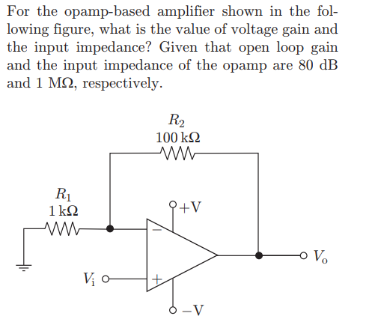

Slide 30
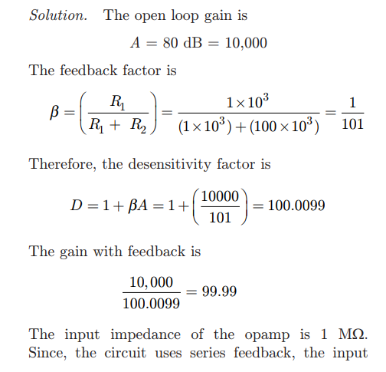


Slide 31
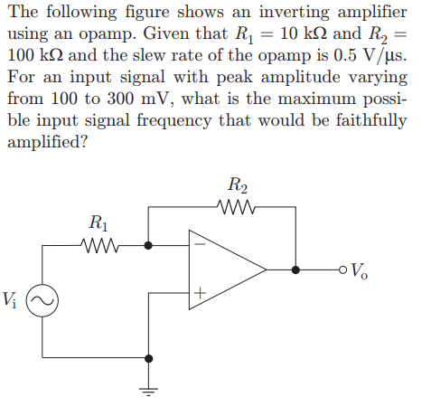

Slide 32
